Slide 1
Env Setup

Slide 2
What we prepared for you—The cloud!
Hardware (Google Cloud VM instance)
1 Virtual cpu
1 x NVIDIA Tesla K80
4 GB RAM
50GB SSD Harddrive
Connection to Internet ☺
Software
Ubuntu 16.04 LTS
Tensorflow 1.3.0
Cuda compilation tools, release 7.5, V7.5.17
cudnn-8.0-linux-x64-v6.0

Slide 3
What you need!!
Hardware
Your favourite, trustworthy developer laptop
White board
Your hart and soul!!!!! And brain
Software
Pycharm Pro 30 days trial
Or your preferred IDE with remote development capability
Or if you are hard core, go with ssh client + vim ☺

Slide 4
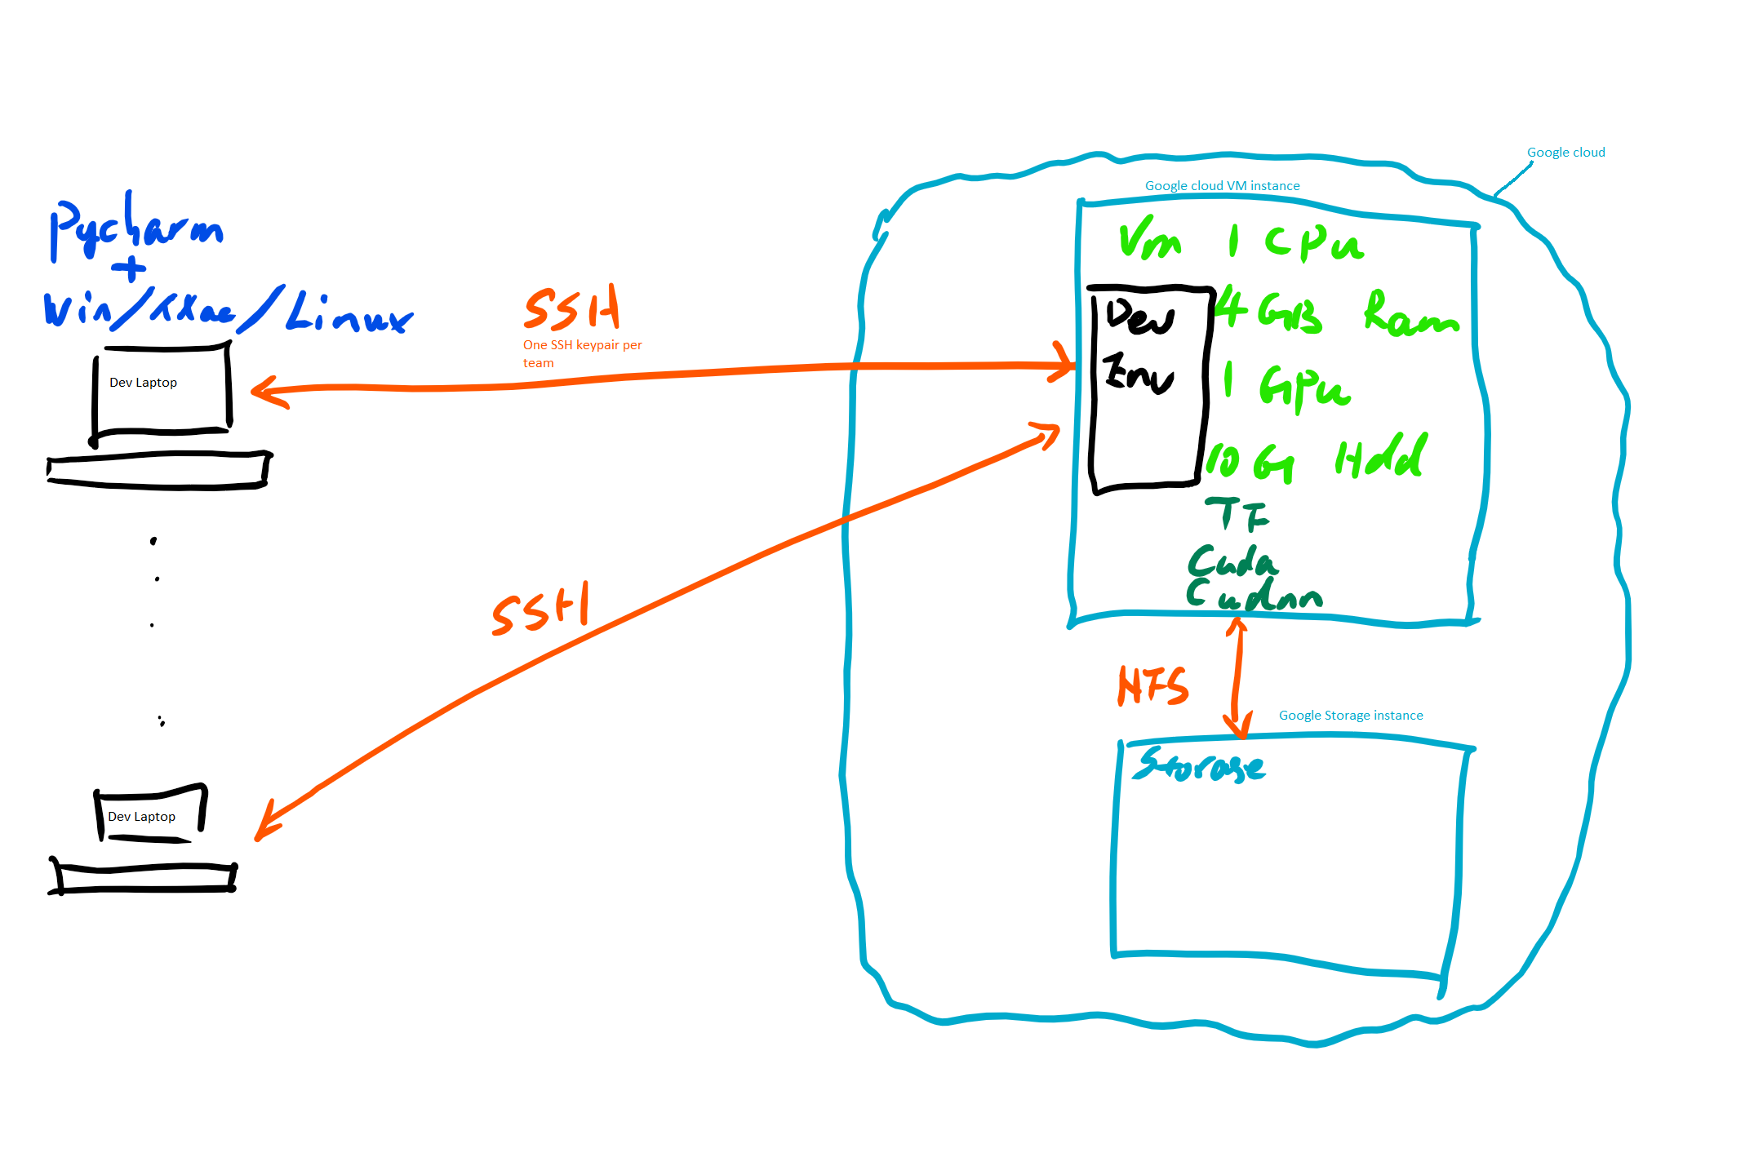
Local Development Env
Notes:
I will keep the instance up for 3 days, the IP should not change without rebooting
I will have one ssh key pair assigned to each team, you can share it between developers, just becareful
Or
I have a key pair for each developer
If you need large file download from internet and wget wont do due to security reason, I can download the file to a nfs server, you can grub from there.

Slide 5
Dev env Setup (Pre)
Download SSH key pair
Download Pycharm Pro (Trail Edition)
IP address of the Cloud Instance (X.X.X.X)

Slide 6
Dev env Setup
Create entry for local host name resolution
Windows: c:\Windows\System32\Drivers\etc\hosts
Linux.Mac: /etc/hosts
Add entry
X.X.X.X ml.mycloud.mii

Slide 7
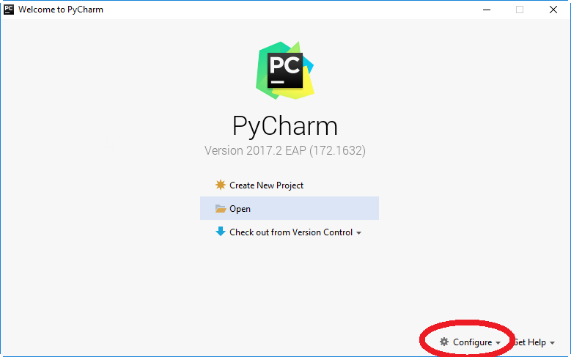
Dev env Setup
Start Pycharm for the first time

Slide 8
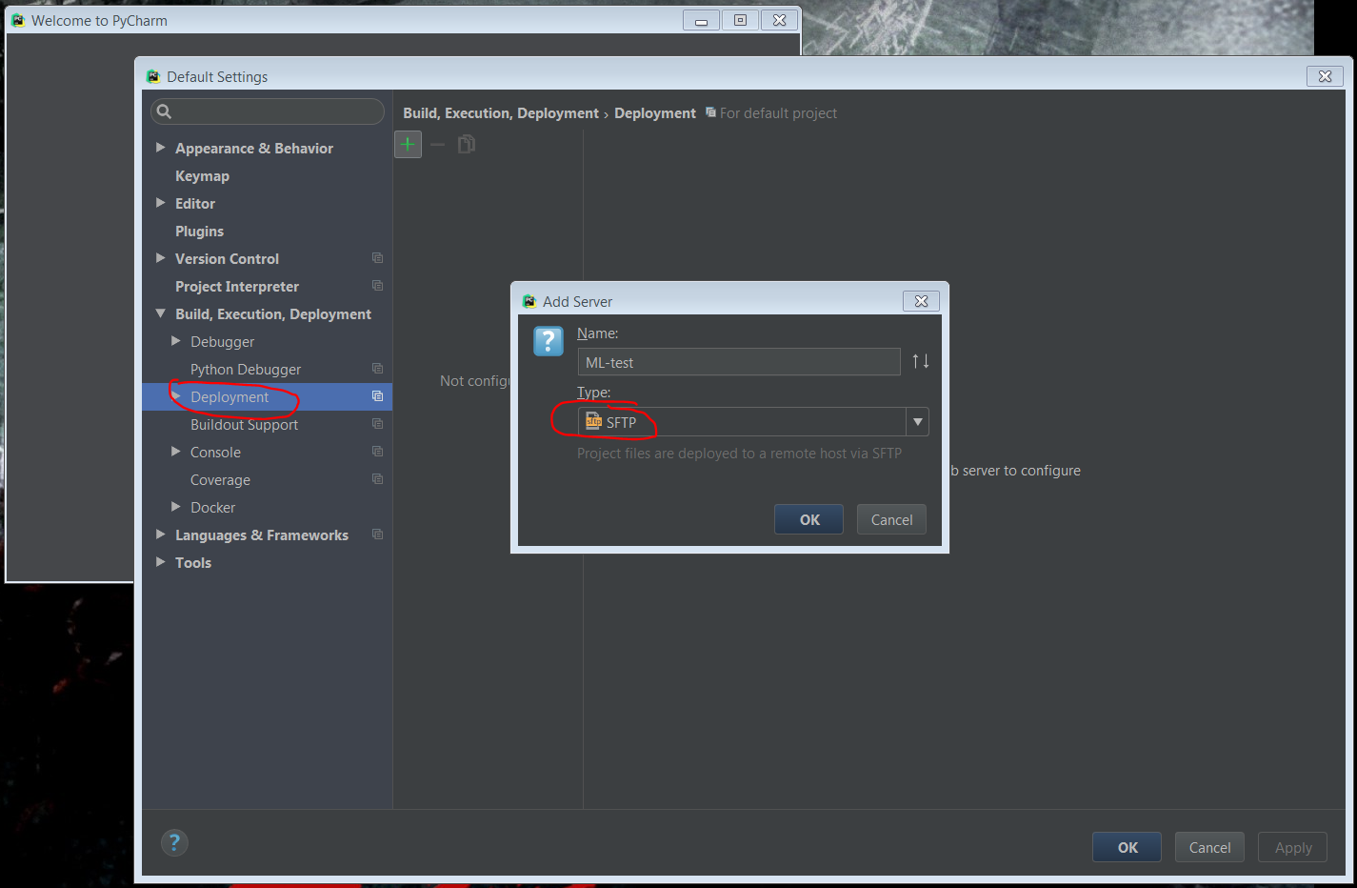
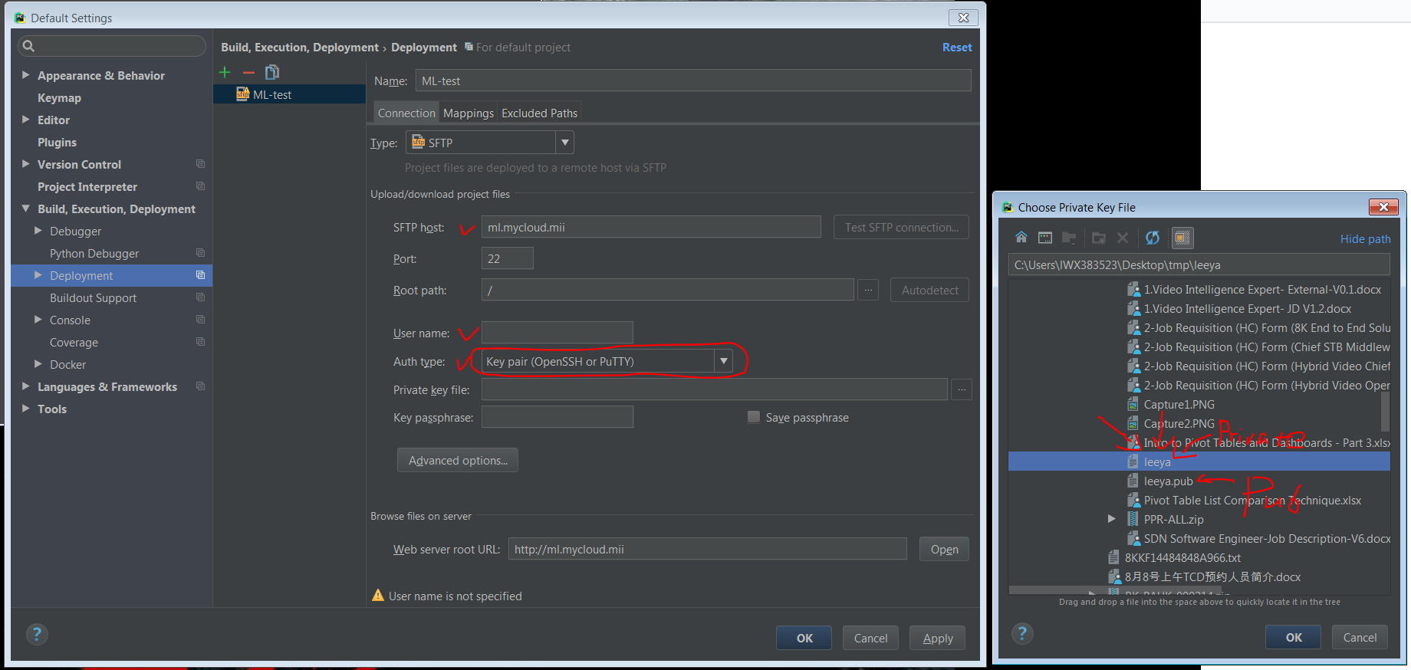
Dev env Setup
Configure remote Deployment env
Locate SSH key pair

Slide 9
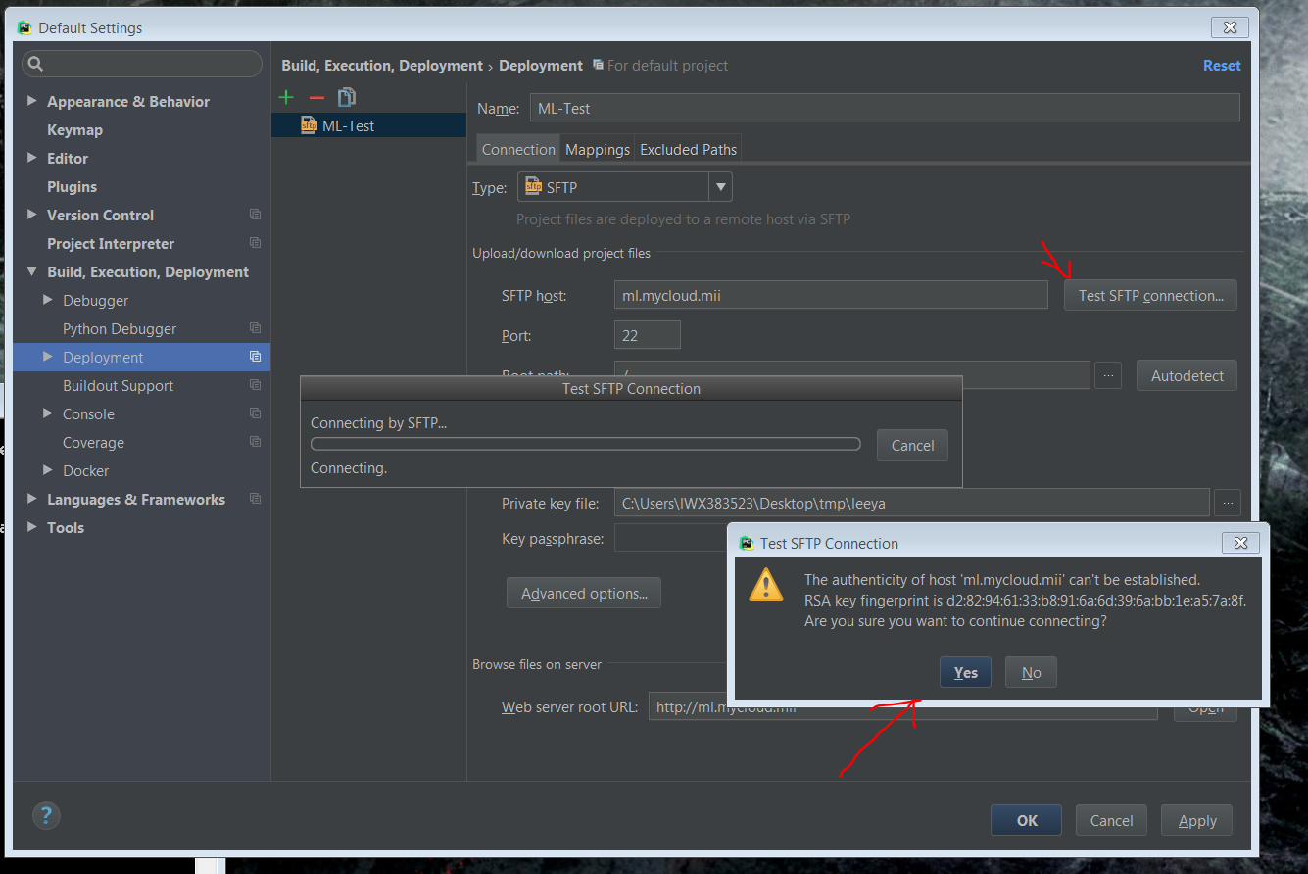
Dev env Setup
Test your connection

Slide 10
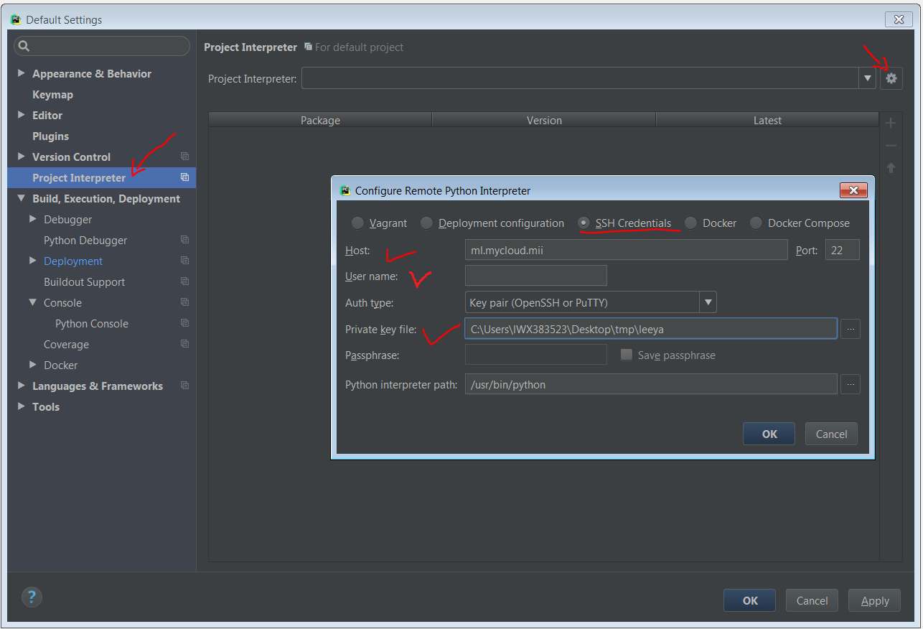
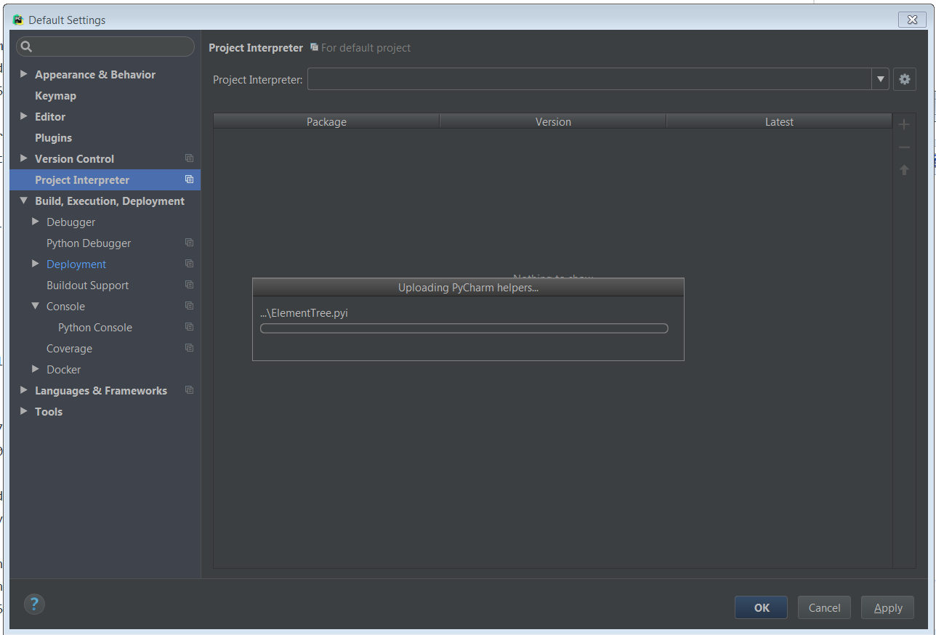
Dev env Setup
Configure remote Python Interpreter
Verify remote interpreter

Slide 11
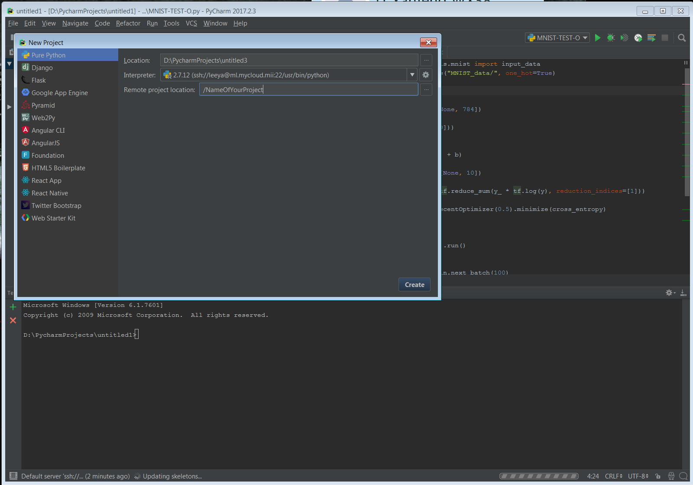
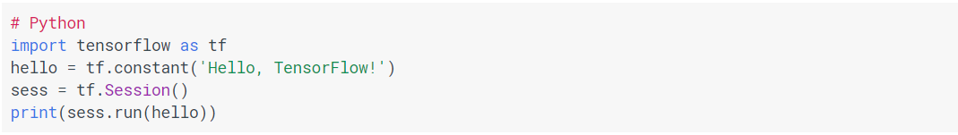
Dev env Setup
Enter the first piece of python + Tensorflow code
“File” – “New Project”
“Hellow World”

Slide 12
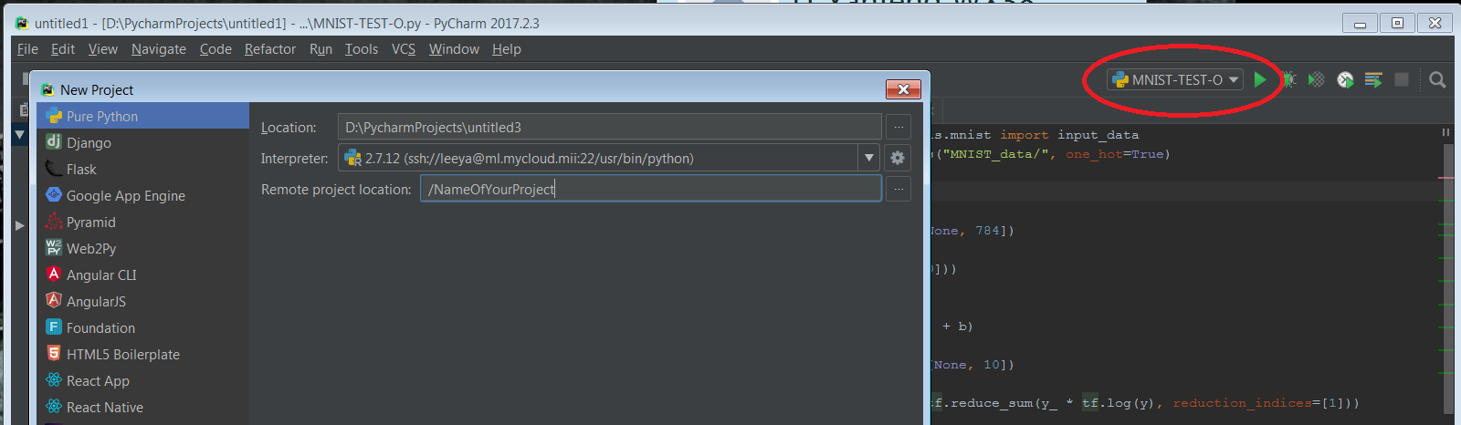
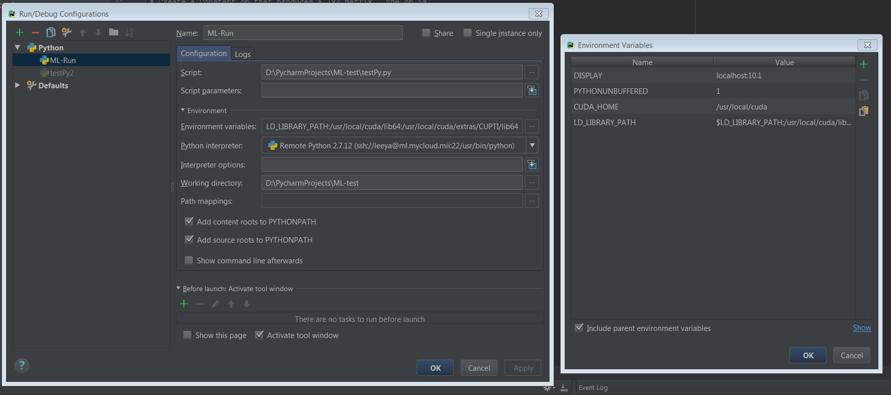
Dev env Setup
Configure remote Running parameter
Tell your remote python where CUDA is!
CUDA_HOME=/usr/local/cuda
LD_LIBRARY_PATH=/usr/local/cuda/lib64/

Slide 13
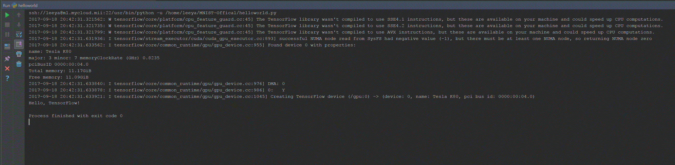
Dev env Setup
Hello World
If this is your first tensorflow app, smile ☺
Else if – go find someone who need help !!

Slide 14
Additional tutorial
MNIST official beginner guide
https://www.tensorflow.org/get_started/mnist/beginners
Tensorboard
https://www.tensorflow.org/get_started/summaries_and_tensorboard
tensorboard --logdir=/logdir/ --host 0.0.0.0 --port 6006
http://ml.mycloud.mii:6006
Transfer learning with tensorflow (Make sure you use the Brazel version)
https://codelabs.developers.google.com/codelabs/tensorflow-for-poets/#0

Slide 16
Some basic requirement
Have some programing or scripting experience (Python preferred)
Have some knowledge of machine learning, deep learning
General understanding is sufficient
Practical experience will be useful
Comfortable to operate under Command line User interface
Provided development environment
Tensorflow + Python Pre-installed
Google Cloud VM instance + Nvidia Tesla K80 GPU + Ubuntu Linux 16.04 LTS
BYOL (Bring your own laptop)

Slide 17
Getting start tutorial
Machine Learning Recipes with Josh Gordon
Google’s ML channel, small video nuggets
Siraj Raval
Crazy dude on internet, short applicable video nuggets. (Some of his code are out of date, may not work with the provided or the latest development environment)
Machine Learning by Stanford University
Stanford course on Coursera, taught by the legendary Andrew Ng
if (really want to go to China && have some spare time ) {learn this;}

